Slide 1
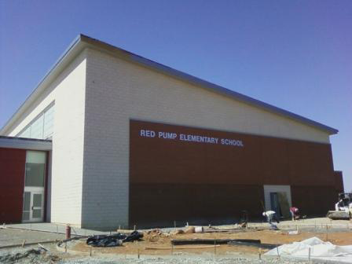
Bi-Partisan Commission
on
School Construction

Slide 2

Resolution 19-09
Bi-partisan Commission on School Construction
Assemble Key Decision Makers
County Council
  Councilwoman Mary Ann Lisanti
  Councilman Richard Slutzky
County Executive
  John Scotten, Treasurer
Board of Education
  Donald Osman
  John Smilko
General Assembly
  Delegate Susan McComas
  Senator J.B. Jennings
Objectives:
Examine Comprehensive Funding Process
Understand Segmentation of Roles / Authority
Identify Public Policy Conflicts
Provide Recommendations for Action

Slide 3

Challenges
Relationship Building
Changing Conditions & Revenue Reduction
Have -vs.- Have-not
Conflicting Policy
Complex funding process

Slide 4

Relationship Building

Slide 5

Changing Conditions and
Revenue Reduction

Slide 6

Have and Have Not

Slide 7

Access to Academic Programs

Slide 8

Public Policy Conflict

Slide 9

Complex Funding Process

Slide 10

Recommendations

Slide 11

Balanced Approach
Need
Affordability

Slide 12

Action Plan
Collectively Adopt funding policy with guiding principles
    Ensure Safety
    Equity
      Facilities
      Programming
    High Return of Investment
      Opportunity to Succeed

Slide 13
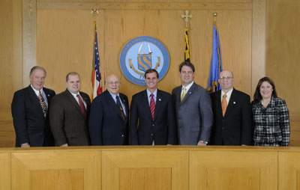
County Council
  Require and fund a comprehensive Educational Facility Master Plan (10 Year Plan)
  Amend the Charter, link budget to CIP
  Appoint a Board of School Construction
  Expand Master Land Use Plan to include Public Facilities Element Plan

Slide 14
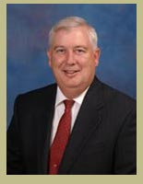
County Executive
  Appoint a Facilities Master Plan Funding Committee
    Examine alternative funding sources
      Public / Joint Use Partnerships
      Public / Private Partnerships
      Lease – Leaseback
      Performance Based Contracting
      Commercial Re-development of County facilities
      Private or Foundation financing

Slide 15

County Delegation
Reform the IAC
  Congruency of budget cycle
  Criteria for state funding
  Require a comprehensive facilities evaluation
  Require local concurrence for project priority
  Redirect state reimbursement

Slide 16

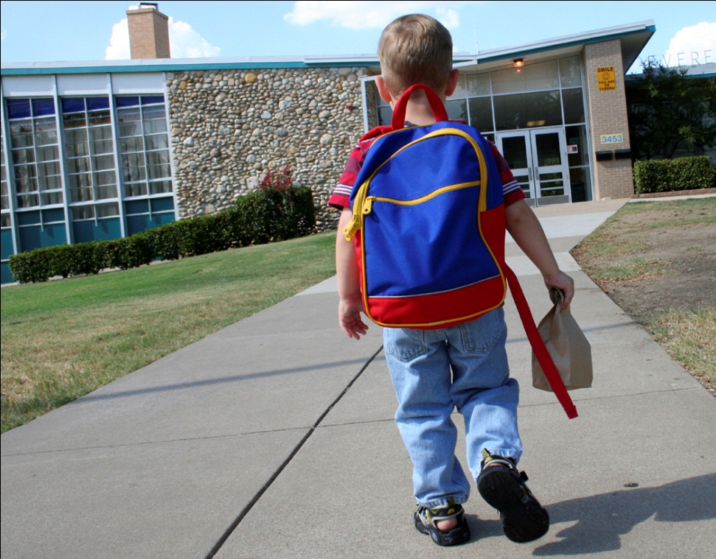
Shared Community Value

